Slide 1
CURRENT PROJECT
Sandeep Mandalapu

Slide 2
Problem statement:
High Energy/Water Losses: The company experiences significant losses in energy or water distribution due to leakages, theft, or inefficient distribution networks. These losses result in financial losses for the company and contribute to resource scarcity and environmental impact.
Inefficient Asset Management: The company struggles to efficiently manage and maintain its assets, such as power plants, water treatment facilities, or telecommunication infrastructure.
Poor Customer Service: Customers face challenges in accessing information, reporting issues, or getting timely responses from the utility company. Inefficient customer service processes, long wait times, and lack of self-service options contribute to customer dissatisfaction.
Outdated Infrastructure and Technology: The utility company relies on outdated infrastructure and legacy systems that lack scalability, integration capabilities, and security features. This restricts its ability to adopt new technologies, implement automation, and leverage digital solutions for process improvement.

Slide 3
Evergy-utility sector usecase:
Predictive Maintenance and Asset Management:
Smart Metering and Consumption Monitoring:
Demand Response and Load Management:
Renewable Energy Integration:
Outage Management and Grid Resiliency:

Slide 4
ABOUT YOUR CURRENT PROJECT:
Currently I was working for Evergy Inc as a Azure Data Engineer
As I’m working in utility sector we get data from different Source. Majority of the data is coming from different IoT devices(telemetric data) which are connected to the machines and also different customers related data where we are in both production and distribution sectors . I’m working on end-to-end operations of creating ETL data pipeline and worked with large data sets in azure data factory
my role in the project is to extract, Transform and load data from various sources. By creating different data pipelines using azure data factory.
These business use cases of Evergy Inc. are efficiency, customer satisfaction, sustainability, and resilience in the provision of electricity services.
Afterall we prepare the data for further analysis team where they visualize the data and identify areas of improvement, and make data-driven decisions.

Slide 5
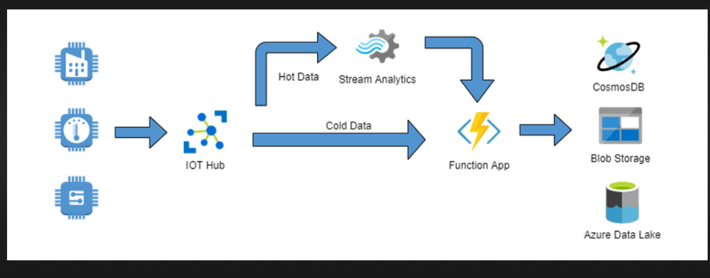

Slide 6
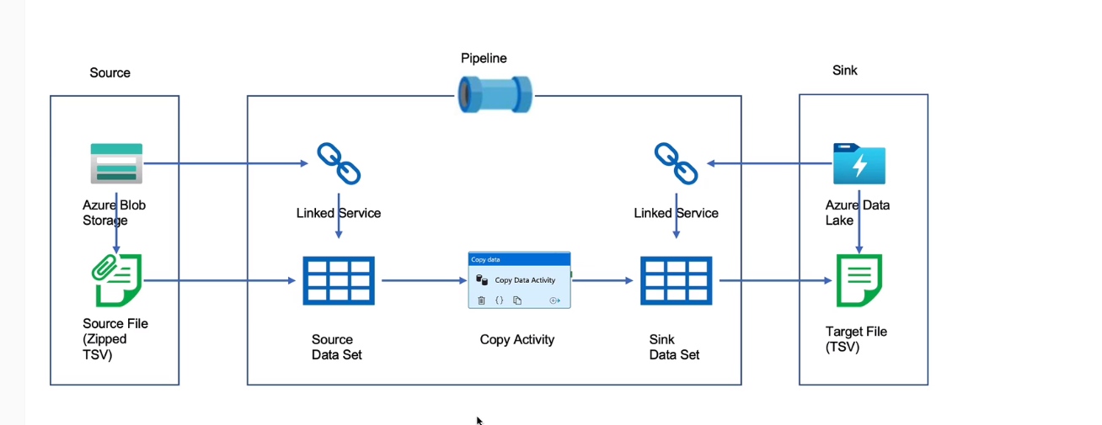

Slide 7
